Slide 1
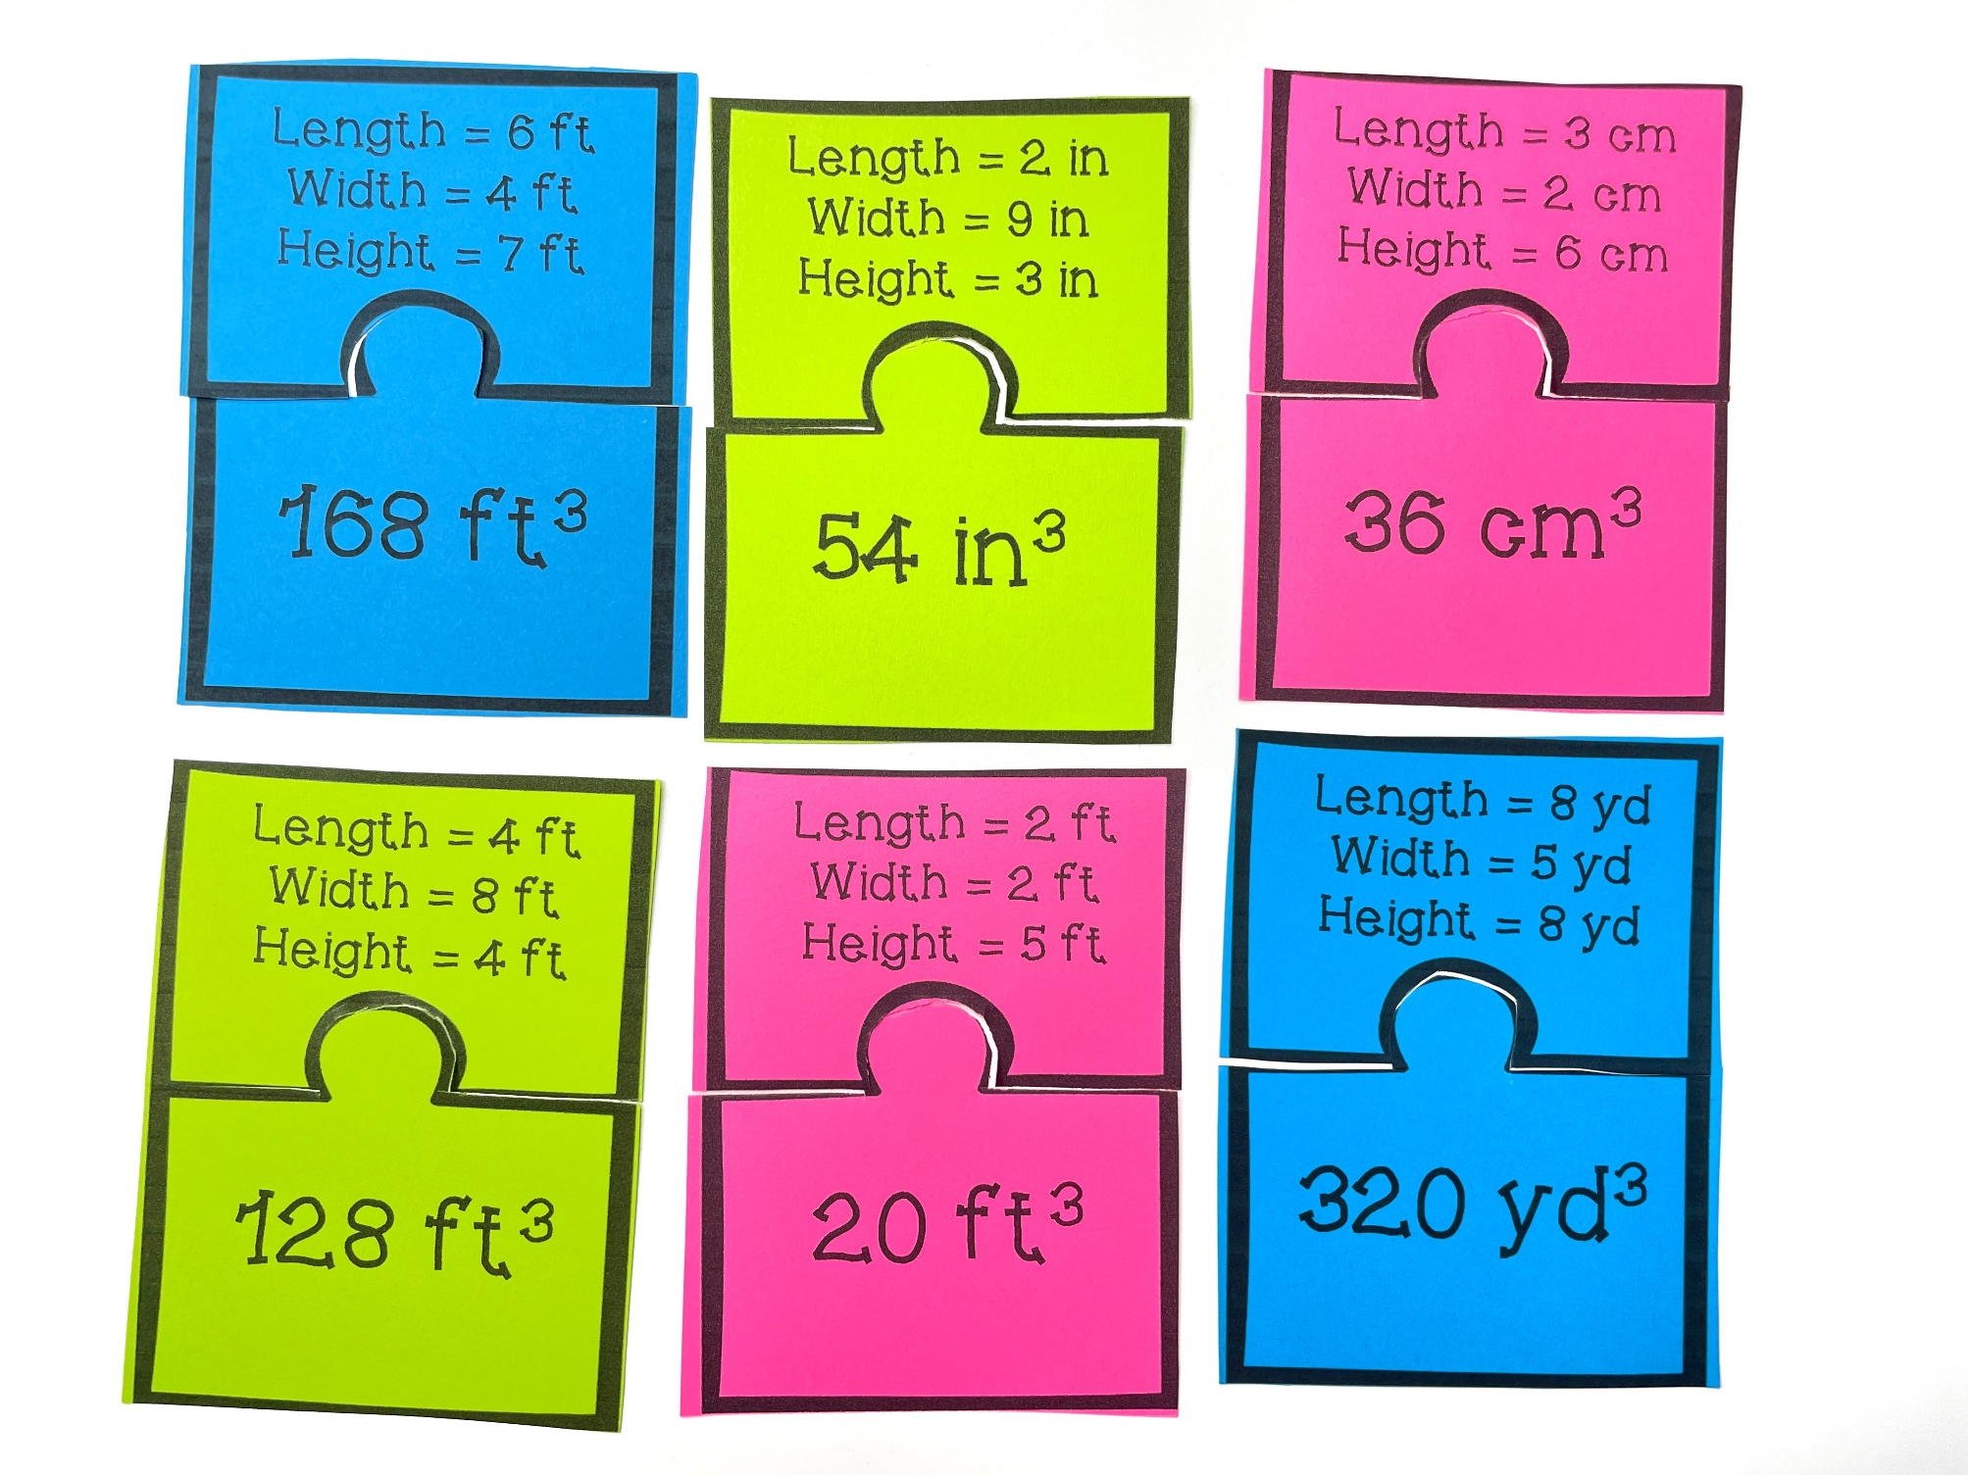
CALCULATING VOLUME
Matching Puzzles
Matching Puzzles
SCROLL
to take a look inside!
© Chloe Campbell

Slide 2
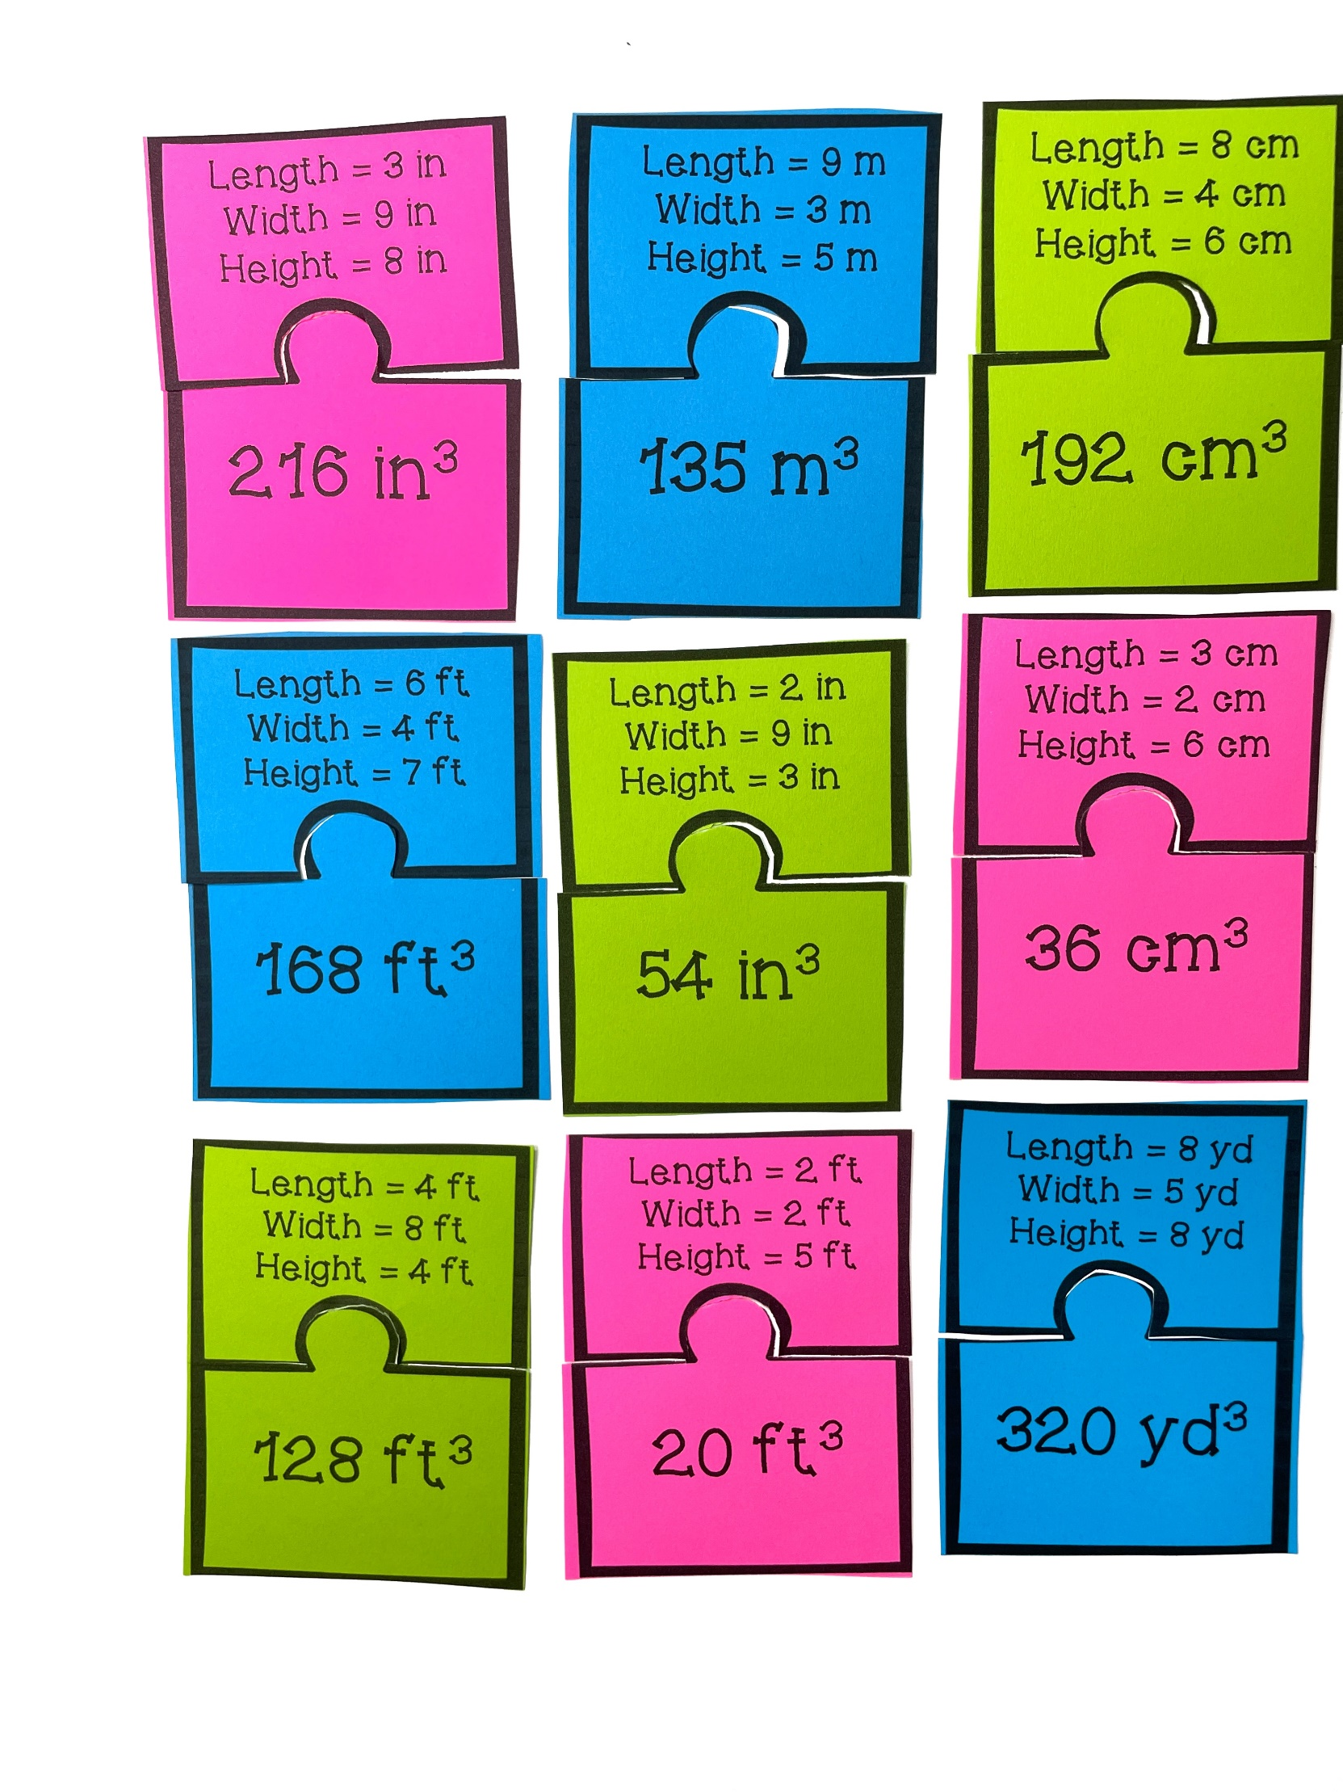
20 Problems Included
© Chloe Campbell

Slide 3
What's Included?
Teacher Directions to make implementation easy for you!
20 Matching Puzzles to give your students extra practice
Student Recording Sheet to hold students accountable
Teacher Answer Key so you can easily check student answers
© Chloe Campbell

Slide 4
Ideas for Use:
Math Centers or Stations
Whole Group Practice
Morning Work
Early Finisher Activities
Substitutes
Send home to engage students’ families
© Chloe Campbell

Slide 5
Teacher Tips
Print the puzzle pieces.
Cut out the puzzle pieces.
Store them in a plastic baggie.
© Chloe Campbell

Slide 6
HAPPY
Great and fun game that students enjoy playing
over and over again!
TEACHERS SAID...
My students loved trying to find the puzzle piece matches, and didn‘t even realize they were doing skill practice in the process!
A fun activity! Students used this as a game during math centers. They also used this as a whole-class matching activity (find your partner). A variety of ways to use this!
© Chloe Campbell

Slide 7
Grab the entire bundle!
Click here!
© Chloe Campbell

